Slide 1


Models of Entrepreneurial Development

Slide 2
Agenda
1
Psychological Models
Models of Entrepreneurial Development
2
Sociological Models
3
Integrated Models

Slide 3
Psychological Models
Lukas
The essence of psychological theory is an understanding of the difference in individuals' attitudes.
McClelland's Theory of Achievement Motivation
Wendy
Theory of Withdrawal of Status Respect (1964)
Lukas
Internal-External Locus of Control Theory
Notes:
Psychological Models
The psychological model is based on the psychological approach to entrepreneurship. The essence of psychological theory is an understanding of the difference in individuals' attitudes. According to this theory, the internal attitude and ability to judge and forecast any situation lead a person to become a successful entrepreneur. David McClelland's theory on need for achievement is the most important among the various psychological theories on entrepreneurship. In his theory. McClelland emphasized the relationship of need for achievement or achievement motivation to eco nomic development via entrepreneurial activities. He considers "achievement motivation" to be the major determinant of entrepreneurial development.
McClelland's Theory of Achievement Motivation
David McClelland has explained entre preneurial development from a psychological perspective. He considers entrepreneurs as people who do things in a better way and make decisions in times of uncertainty. He argues that motivation is an important determinant for entrepreneurial growth. The dream to achieve big things overpowers monetary or other external incentives. The McClelland Theory of Achievement Motivation holds that people have the following three motives for accomplishing things:
Need for Power (nP), or the drive to influence others and any given situation.
Need for Affiliation (nAff), or the drive for interpersonal relationship.
Need for Achievement (nAch), or the drive to excel, advance, and grow.
McClelland suggests that all of these three needs may simultaneously act on an individual. However,in the case of an entrepreneur, the need for achievement is found to dominate.
Theory of Withdrawal of Status Respect (1964)
Everett Hagen's concept of the entrepreneur is that of a "creative personality" interested in accelerating change and driven by a motivation to achieve. According to Hagen, entrepreneurial growth has been very gradual and may or may not even occur in the same generation. In his theory of withdrawal of status respect, Everett Hagen's argument is that certain social changes may disrupt the stability of traditional society and cause pay chological changes in a group or in an individual. The withdrawal of status respect may occur when a traditional, group is displaced from its previous status or on migration to some other place or to a new society." Hagen uses the case of Japanese history to substantiate his argument
Internal-External Locus of Control Theory
Professor J. D. Rotter of Ohio University introduced the Internal-External Locus of Control Theory, which highlights the self-confidence of a person, and the dependency on fortune and external environment for becoming an entrepreneur According to this theory, the internal locus of control comprises self-confidence, extreme belief in one's own ability, and initiatives taken by an individual. Locus of control determines whether a per son perceives a potential goal to be attainable through one's own actions (internal locus of control) or through uncontrollable external factors (external locus of control).

Slide 4
Sociological Models
Max Weber's Theory of Religious Beliefs
Hozelist's Sociocultural Theory
Thomas Cochran's Theory of Entrepreneurial Supply
Frank W. Young's Theory of Group Level Pattern
Notes:
Sociological Models
The sociological theory of entrepreneurship holds social cultures to be the driving force behind entrepreneurship. The entrepreneur becomes a role performer in conformity with the role expecta tions of society. Such role expectations are based on religious beliefs, taboos, and customs. Max Weber, Hozelist, Thomas Cochran, and Frank W. Young all advocated a sociological explanation for the development of entrepreneurship.
Max Weber's Theory of Religious Beliefs
According to Max Weber, religious beliefs are the driving or restraining forces for entrepreneurial activity. For one thing, religious beliefs play a crucial role in determining the attitude of the entrepreneur towards generating or limiting profits. Weber took the position that entrepreneurial growth is dependent upon the ethical values (due to religion) of society.
Weber stressed the spirit of capitalism, which promotes a favourable attitude in society towards the acquisition of wealth. Capitalism thrives under the Protestant work ethic that advocates hard work, honesty, and discipline. The spirit of capitalism, coupled with the motive of profit, results inthe creation of a large number of successful business enterprises.
Weber distinguished between the "spirit of capitalism" and the "adventurous spirit." The spirit of capitalism is influenced by a strict discipline, whereas the adventurous spirit comes from the free force of impulse. The right combination of discipline and impulse defines the successful entrepreneur.
Hozelist's Sociocultural Theory
According to Hozelist, a specific social culture leads to growth in entrepreneurship. Social sanctions, cultural values, and role expectations are responsible for the emergence of entrepreneurship. He also propounded that entrepreneurship grows in societies that permit variability in choice of paths of life and non-standard socialization of individuals. Hozel ist's approach emphasizes the theory of deviance and assumes that those who introduce changes must be deviants since they reject the traditional way of doing things.
Thomas Cochran's Theory of Entrepreneurial Supply
Thomas Cochran, in agreement with Hozelist, believed that the environment in which an individual is brought up determines his entrepreneurial urge. According to him, the supply of entrepreneurs in society needs to be seen with reference to prevailing child-rearing practices. He stated that the performance of the entrepreneur might be seen in reference to his own attitudes towards an occupation. Values and role expectations of the particular social group to which he belongs are the most important determinants in the performance of business entrepreneurial roles.
Frank W. Young's Theory of Group Level Pattern
Frank W. Young's theory of entrepreneurship is one of change based upon society's incorporation of relative sub-groups within society. He said that groups can be reactive in two ways: If a group experiences low status recognition and denial of access to important social networks, and if the group possesses a greater range of institution resources than other groups at the same system level. These two factors bring development to the society. A group without anything will compete with other groups and also try to acquire societal recognition. A sub-group that has a relatively low status in a larger society willlead to entrepreneurial behaviour if the group has better institutional resources than others in thesociety at the same level. Young's model of entrepreneurship suggests the creation of supportinginstitutions in society, such as the family, as the determinant of entrepreneurship.

Slide 5

Integrated Models
In search of an integrated approach, the behaviourists tried to synthesize psychology and sociology to explain entrepreneurship. However, there has been a dominant influence of psychological parameters in their interpretation of entrepreneurial behaviour.
Notes:
Integrated Models
In search of an integrated approach, the behaviourists tried to synthesize psychology and sociology to explain entrepreneurship. However, there has been a dominant influence of psychological parameters in their interpretation of entrepreneurial behaviour. In Udai Pareek and T. V. Rao's theoretical framework for analysing entrepreneurship, they argue that there are some sequential propositions in human behaviour that lead to entrepreneurship. According to them, these propositions, which occur in sequence, ultimately end up in entrepreneurial development. According to T. V. Rao, the optimal presence of the following factors, which are additive in nature, leads to the initiation of entrepreneurship:
Need for motive (achievement motivation) the dynamic which is the main thrust behind entrepreneurial action.
Long-term involvement in thought and action to achieve the goal in entrepreneurial activity.
Personal, social, and material resources favourable to entrepreneurial activity.
Sociopolitical system suitable for the establishment, development, and expansion of an enterprise.

Slide 6

What is the difference between Managers and Entrepreneurs
??

Slide 7
 | Manager | Entrepreneur
Primary Motives | Wants promotion and traditional corporate rewards. Power-motivated. | Wants freedom, goal-oriented, self-reliant, and self-motivated
Time Orientation | Respond to quotas and Budgets, weekly, monthly, quarterly, annual planning horizons, the next promotion or transfer. | End goals of 5-10-year growth of business in view as guides. Takes action now to move the next step a long way
Action | Delegate action. Supervising and reporting take most of energy | Gets hands dirty. May upset employees by suddenly doing their work.
Skills | Professional training. Often business-school trained. Abstract analytical tools, people-management, and political skills. | Knows business intimately More business acumen than managerial or political skill. Often technically trained f in technical business. May have former P&L responsibility in corporation

Slide 8
 | Manager | Entrepreneur
Courage and Destiny | Sees others in charge of his or her destiny. Can be forceful and ambitious, but may be fearful of others' ability in case of optimism. | Self-confident, optimistic, courageous.
Attention | Primarily on events inside corporation. | Primarily on technology and marketplace.
Risk | Careful | Likes moderate risk. Invests heavily, but expects to succeed.
Market Research | Has market studies done to discover needs and guide product conceptualization. | Creates needs. Creates products that often can't be tested with market research potential customers don't yet understand them. Talks to customers and forms own opinions.

Slide 9
 | Manager | Entrepreneur
Status | Cares about status symbols (corner office, etc.) | Happy sitting on an orange crate if job is getting done.
Failure and Mistakes | Strives to avoid mistakes and surprises. Postpones recognizing failure. | Deals with mistakes and failures as learning experiences.
Decisions | Agrees with those in power. Delays decision until he gets a feel of what bosses want. | Follows private vision. Decisive and action-oriented.
Who they Serve | Please others. | Pleases self and customers.

Slide 10
 | Manager | Entrepreneur
Attitude Toward the system | Sees system as nurturing and protective, seeks position within it. | May rapidly advance in a system, when frustrated, reject the system and form his or her own.
Problem-solving Style | Works out problems within the system. | Escapes problems in large and formal structures by leaving and starting over his own.
Family History | Family members worked for large organizations. | Entrepreneurial small-business, professional, or agricultural background.
Relationship with Parents | Independent of mother, good relations with father, but slightly dependent. | Absent father or poor relations with father.

Slide 11
 | Manager | Entrepreneur
Socio-economic Background | Middle-class background. | Lower-class background in some early studies, middle class in more recent ones.
Educational Level | Highly educated. | Less well educated in earlier studies, some graduate work but not Ph.D. in later ones.
Relationship with Others | Hierarchy as basic relationship. | Transactions and deal making as basic relationship.

Slide 12
Similarities between Managers and Entrepreneurs
Focusing on the different perspective within each similarity

Slide 13
Areas of Similarity
To produce results
Managers
Entrepreneurs
Results of today, this month, this year. Short-term and medium-term.
Results of tomorrow, next year and coming five years. Long-term and very long-term.

Slide 14
To produce results through people
Managers
Have usually to handle people oriented to day-to-day management nitty-grity and nuts and bolts type- Men of details.
Entrepreneurs
Have to deal with people who can conceptualise with aggregate perspectives. -Strategists

Slide 15
To take decisions
Managers
Entrepreneurs
Operational and administrative decisions, which have a bearing on short-term and medium-term results.
Mostly strategic decisions, involving growth through expansion, diversification, take overs and mergers.

Slide 16
To co-operate under constraints
Managers
Entrepreneurs
The constraints are usually organizational, i.e., those within an organization like machine capacity, labor productivity, routing and scheduling, information availability, financial limitations etc.
The constraints are usually environmental which lie outside an organization like the policy of financial institutions, import policy, licensing policy, infrastructural constraints etc.

Slide 17
To follow sound principles of management
Managers
Entrepreneurs
The principles are more oriented towards internal administration and control like delegation, accountability, responsibility, planning, budgeting, reporting and information system.
The principles are with reference to macro social aspects like social responsibility, equal opportunity, employment, ethical advertisement practices, adherence to government policies, etc.

Slide 18
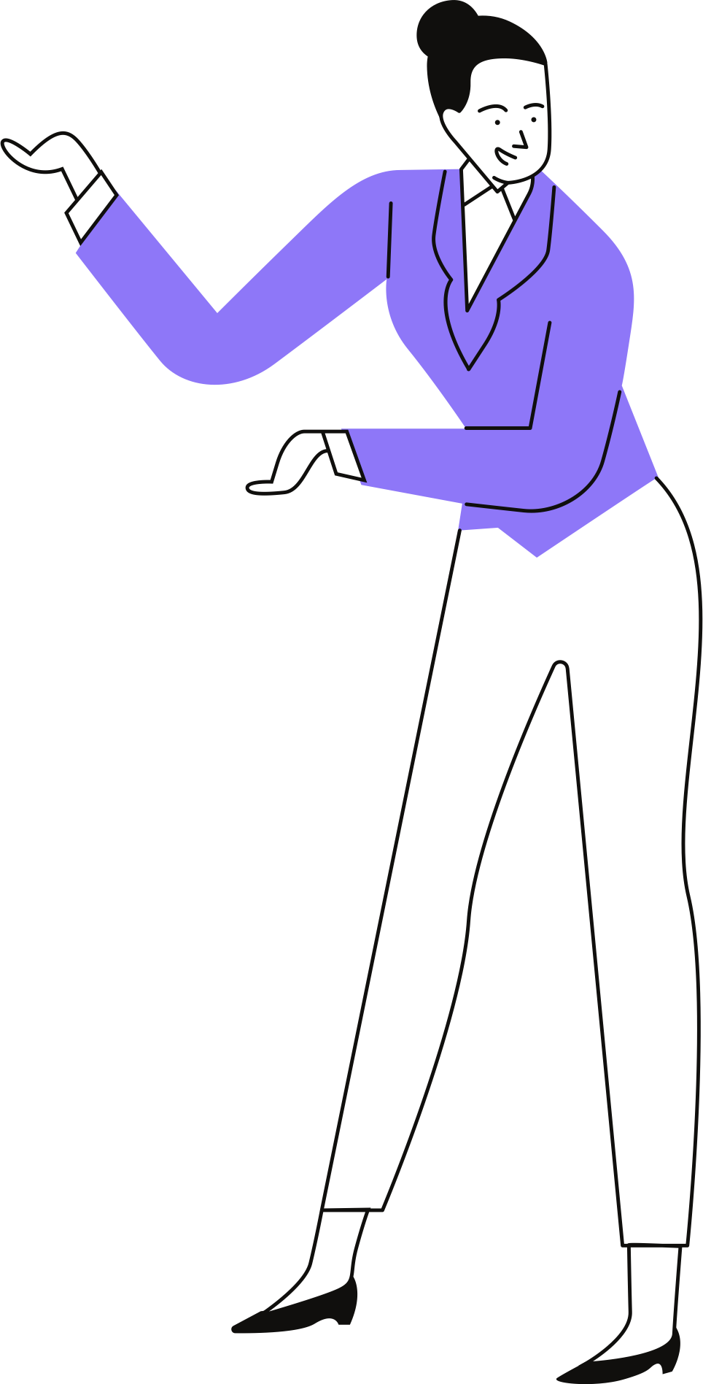


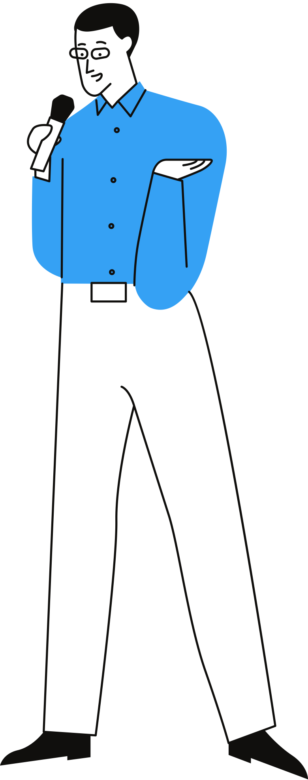
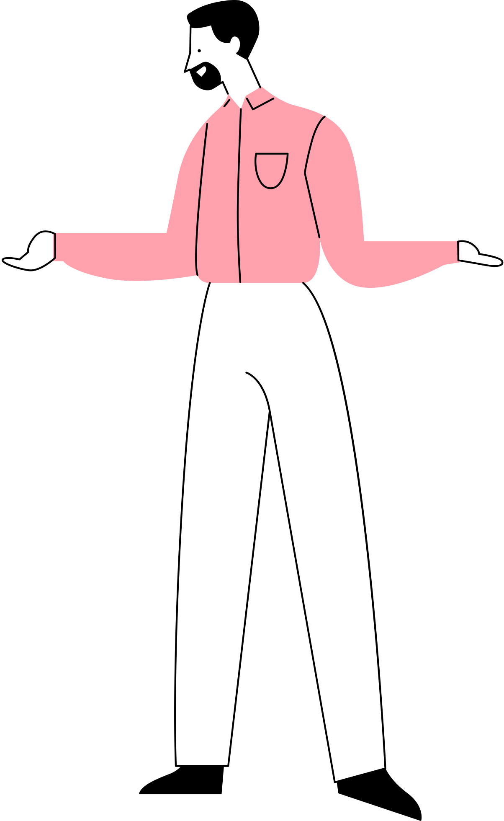

Business Opportunity Identification
A set of favourable circumstances in which an entrepreneur can exploit a new business idea that has the potential to generate profit.
Fundamental Features:
They create or add significant value to the customer.
They Solve Significant Problem
They have robust market, margin and money
They are a good fit with founders and management teams.

Slide 19
Sources of Business Idea
A resolved problem faced by an actual or potential entrepreneur
An unmet customer need discovered by actual or potential entrepreneur at a place of employment.
Changes in the business environment

Slide 20
What Defines a good business opportunity??
An idea is a thought or a concept that comes into existence in the mind as a product or mental activity.
A business idea is an idea that can be used for commercial purposes.

Slide 21
Urgency of the market need
Adequate market size
Potential brand value
Sound business model
An able management team
Five step framework to screen business idea

Slide 22
When is an Idea an Opportunity ??
Attractiveness
Relevant
Durability
Creative and Innovative
Timeliness

Slide 23
How to Generate Business Idea
Brainstorming
Survey Method
Reverse Brainstorming
The gordon method
What leads to the creation of oppotunities
Technological changes
Political and Regulatory changes
Social and Demographic changes
Economic changes

Slide 24
How to identify a business opportunity
Observing Trends
Solving a Problem
Finding gaps in the market

